Slide 1

Baseball, A Great Sport
Galen Curley

Slide 2

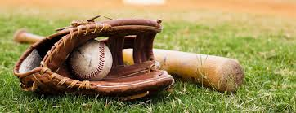
Introduction
I believe that baseball is a great sport.
Baseball is a game that you play with two teams of 9 players each.
The objective of the game is to score as many runs as you can.
Runners occupying bases score when they make it back to home plate.
The team with the most runs at the end of the game wins.

Slide 3
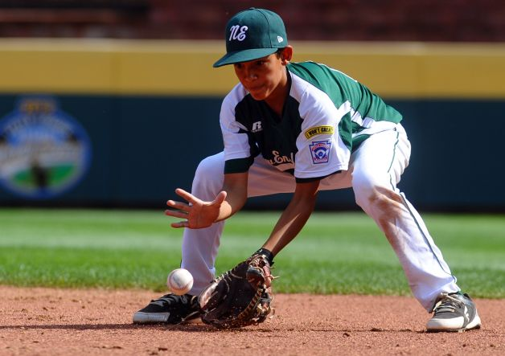
Baseball is a grand game.
You can have a great time playing different positions.
Baseball can be also amusing when you change the rules of the game.
There are many different leagues with different rules such as Little League, Babe Ruth Baseball, Recreational Ball, and Travel Ball.

Slide 4
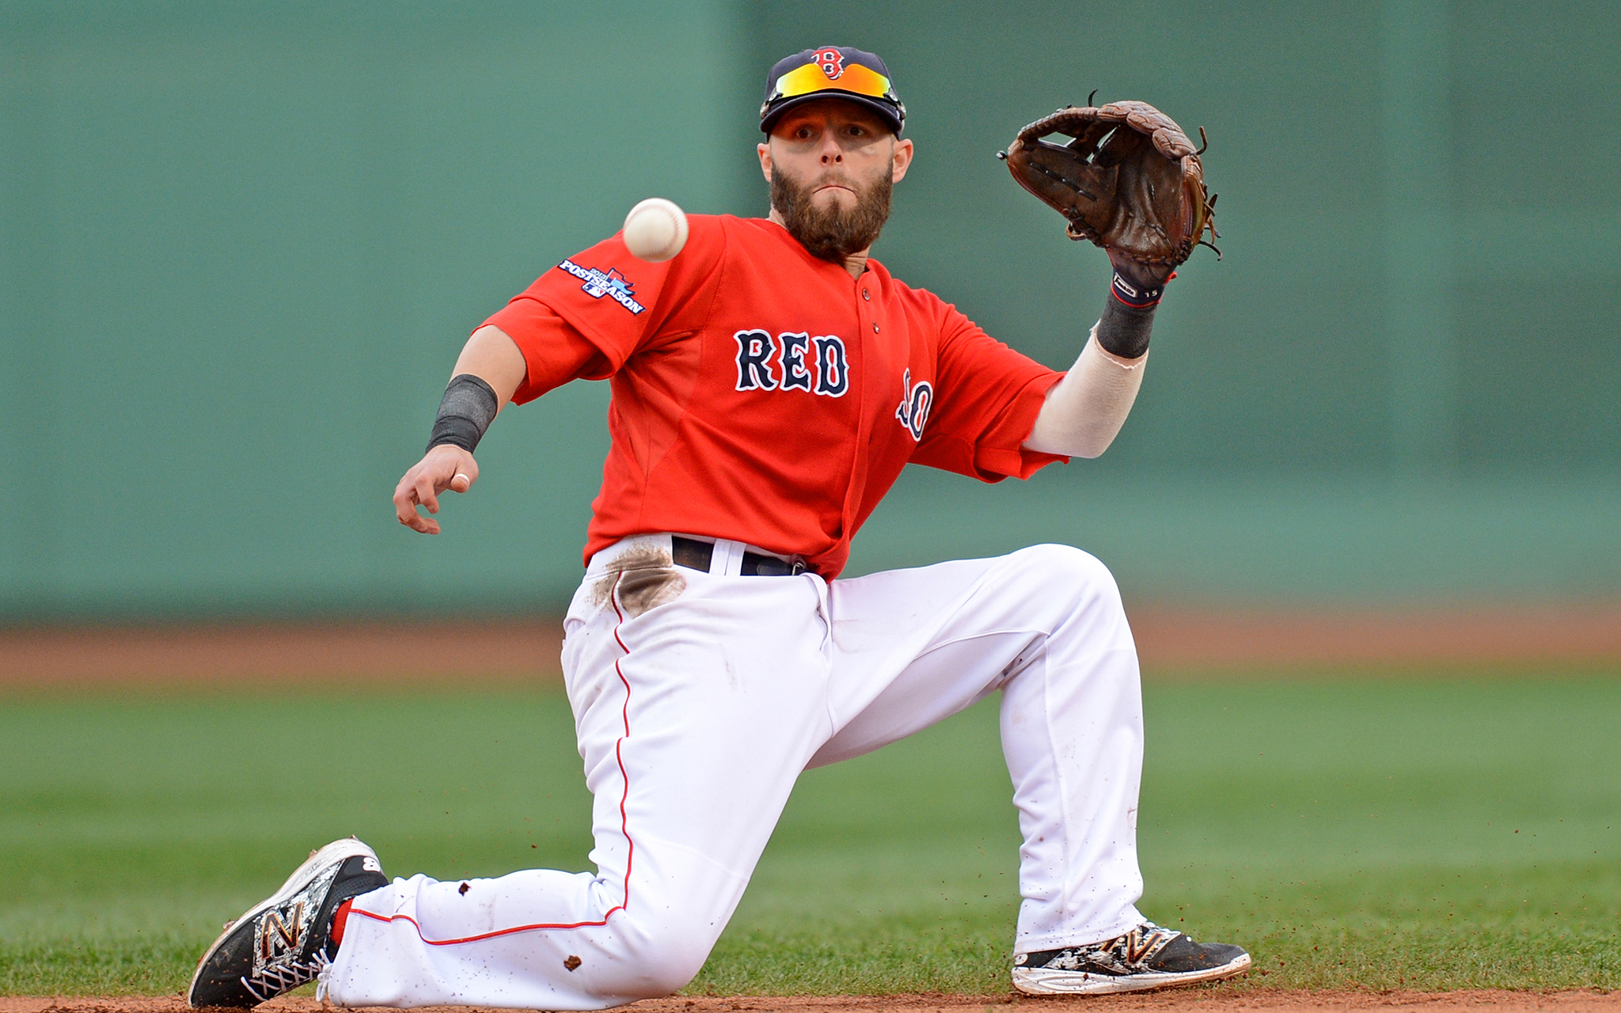
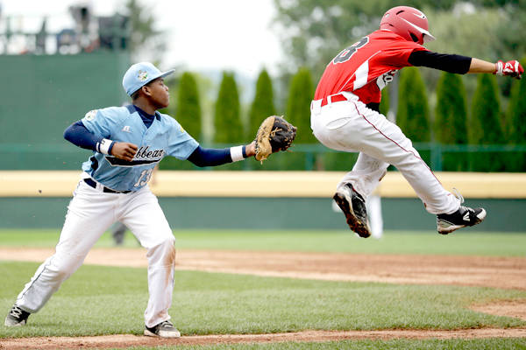
Baseball is great to play at any age.
Remaining more active in physical activities such as baseball can lead to a longer, healthier, and happier life.
There are many different age groups such as 4-6, 7-9, 10-12, 13-16, and 50+. Baseball can be taught at any age.

Slide 5
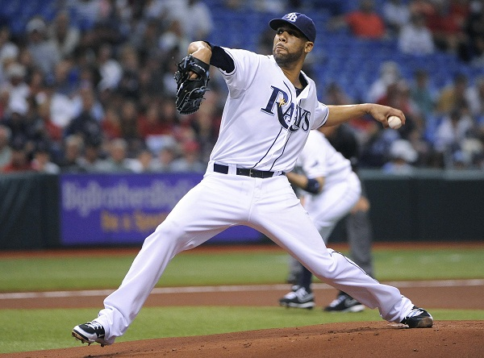
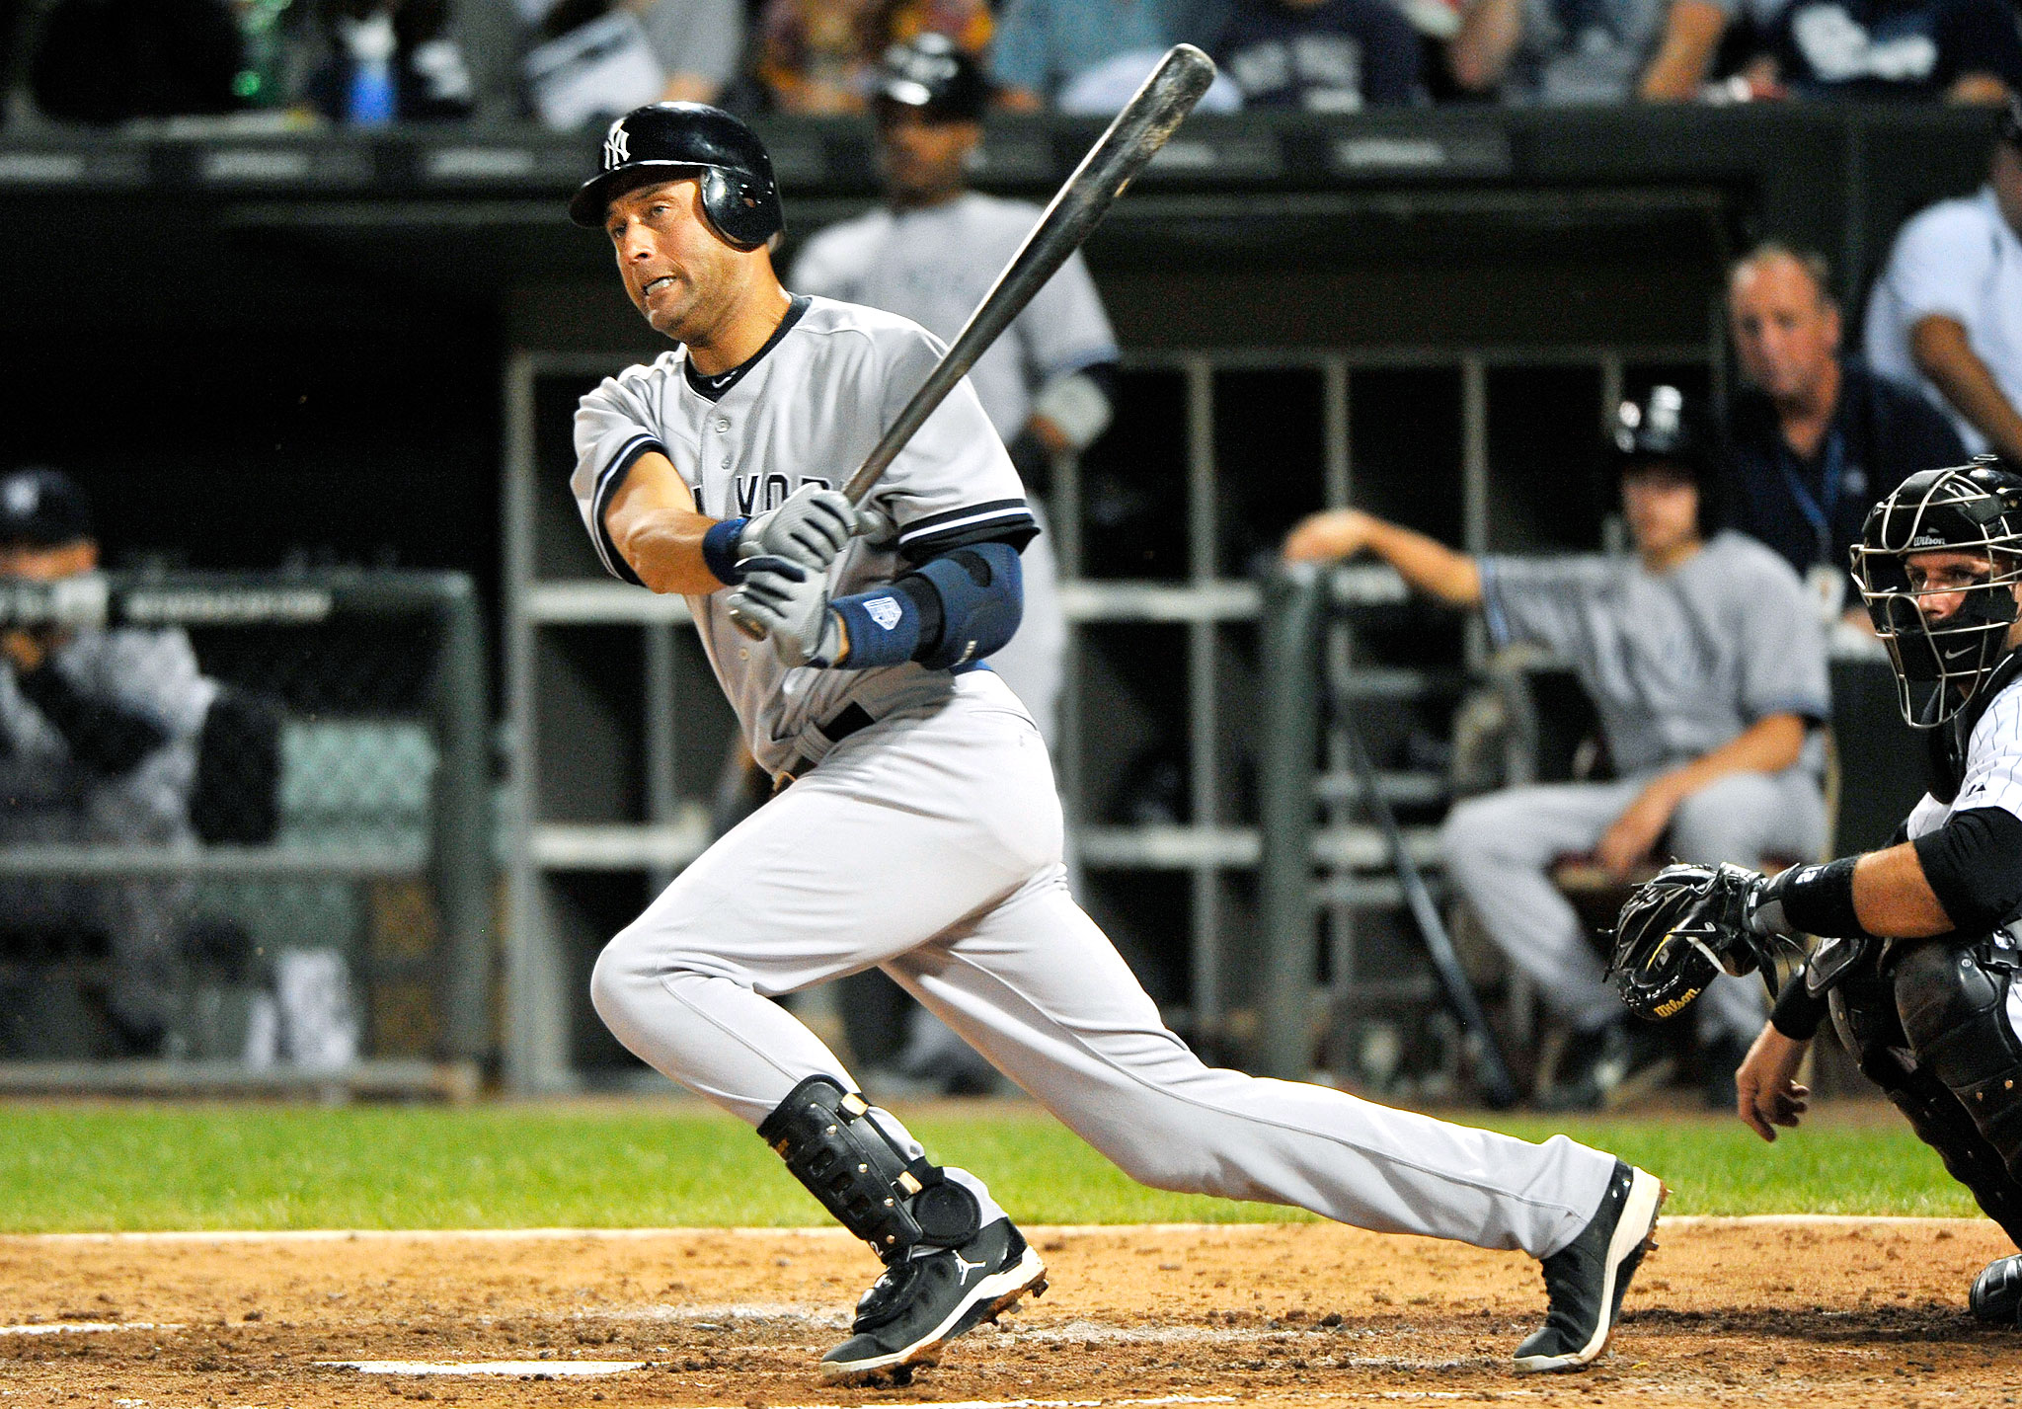
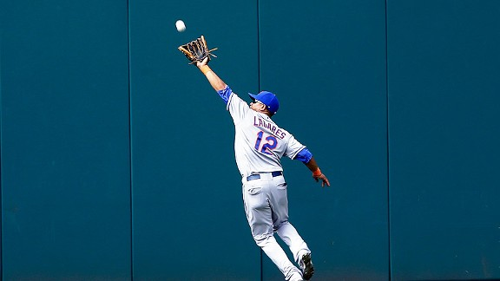
Baseball is great for your mind and body.
Baseball is good for you because it can be a very active game.
Baseball situations help keep your mind and body sharp and fit.
Baseball mechanics for pitching, fielding, and throwing keep your body in great shape.

Slide 6

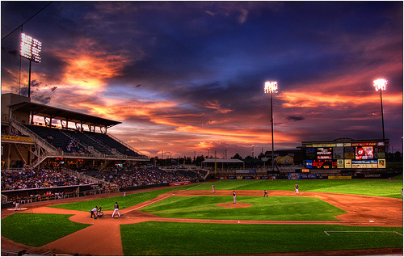
Conclusion
Baseball is a wonderful and great sport.
The game of baseball is entertaining.
No matter what age you are baseball is awesome.
When you play baseball it is great exercise for your mind and body.

